Slide 1
Fire Codes
The reason fire codes exist

Slide 2
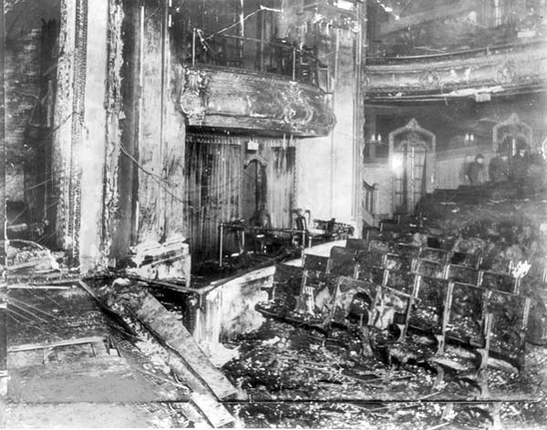
Iroquois Theater Fire
September 30, 1903
Chicago, Illinois
602 Deaths
Codes changes in maximum seating capacity, exit signage, exit doors, and inclusion of sprinklers.

Slide 3
Iroquois Theater Fire
Building Commissioner George Williams and Fire Inspector Ed Laughlin looked over theater in November 1903 and declared it “fireproof beyond all doubt”.
Williams was charged and convicted of misfeasance.
Chicago’s Mayor was indicted, though charges did not stick.
The theater owner was convicted of manslaughter due to the poor safety provisions. The conviction was later appealed and reversed.
Only person to serve jail time was a saloon owner who robbed the dead bodies while his saloon was being used as a morgue.

Slide 4
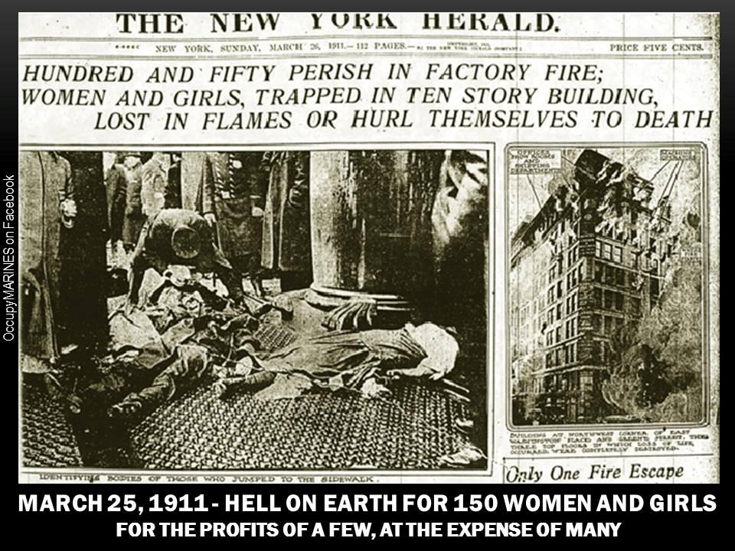
Triangle Shirt Waist Company
March 25, 1911
146 Deaths
NFPA 101 Life Safety Code was developed
Code changes in sprinklers and high-rise exits

Slide 5
Triangle Shirtwaist Company
New York City District Attorney Charles Whitman decided to indict the owners of the Triangle Shirtwaist Factory on charges of manslaughter, on the grounds that they had known that the second door was locked.
Max Blanck and Isaac Harris were indicted in April 1911, as the D.A. moved swiftly. The trial was held over three weeks, beginning on December 4, 1911.
The result? Jurors determined that there was reasonable doubt whether the owners knew that the doors were locked. Blanck and Harris were acquitted.
There were protests at the decision, and Blanck and Harris were re-indicted. But a judge ordered them acquitted on the grounds of double jeopardy.
Civil suits were filed against Blanck and Harris on behalf of those who had died in the fire and their families -- 23 suits total. On March 11, 1913, nearly two years after the fire, these suits were settled -- for a total of $75 per victim.

Slide 6
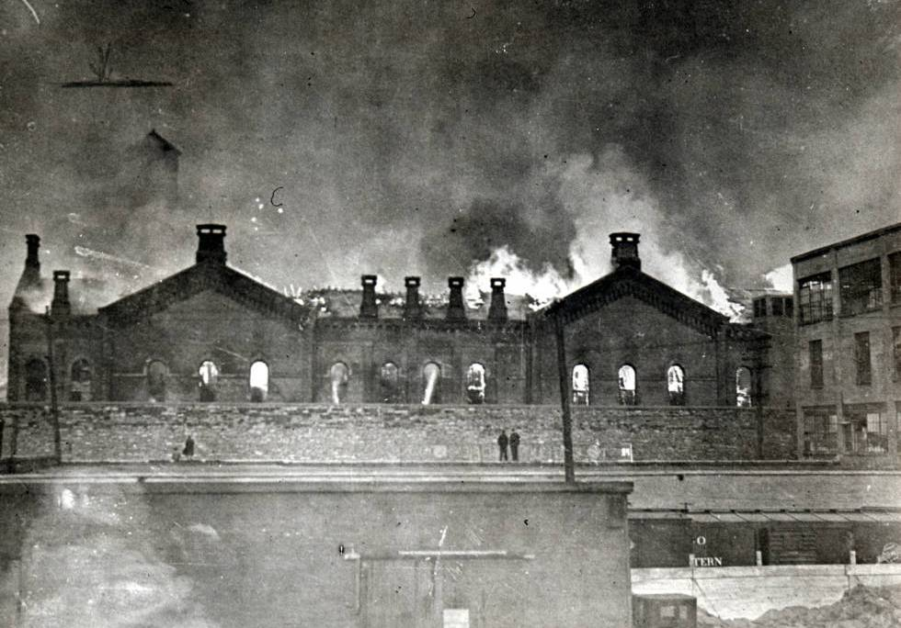
Ohio State Penitentiary
April 21, 1930
322 Deaths
Code changes for jails and prisons which were added to NFPA 101 Life Safety Code

Slide 7
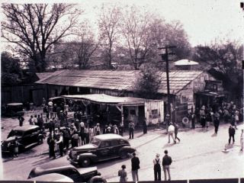
Rhythm Club Fire
April 23, 1940
Natchez, Mississippi
209 Deaths
Church remodeled to a nightclub
Code changes for required number of exits in night clubs

Slide 8
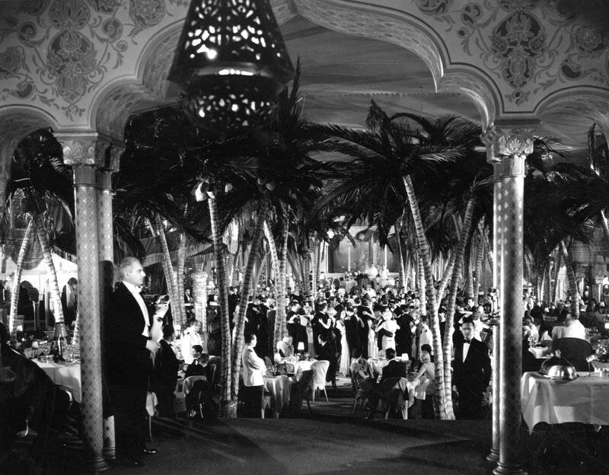
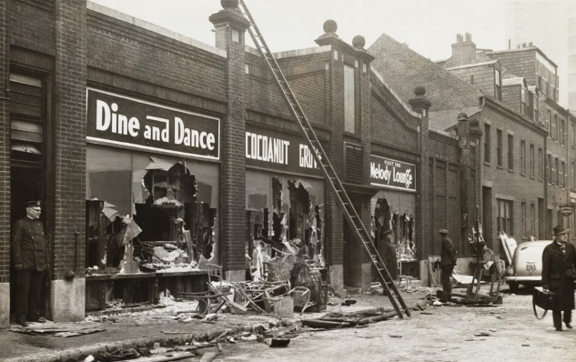
Cocoanut Grove Nightclub Fire
November 28,1942
Boston, Mass
492 Deaths, 200 Injured
Code Changes: Outward Swinging doors, Collapsible revolving doors, Number of Exits, Battery operated emergency lights, and flammability requirements

Slide 9
Cocoanut Grove Nightclub Fire
Three separate investigations started immediately after the fire
Ten indictments:
Barney Welansky, Owner, Manslaughter
James Welansky, Owner’s Brother and Person in charge, Manslaughter
Jacob Goldfine, Wine Steward, Manslaughter
Frank Linney, Fire Lieutenant, Neglect of duties
Police Captain Buccigross, Neglect of duties
James Mooney, Building Commissioner, Neglect of duties
Theodore Eldracher, Building Inspector, Conspiracy to violate building codes
Ruben Bodenhorn, Architect, Conspiracy to violate building codes
Samuel Rudnick, Contractor, Conspiracy to violate building codes
David Gilbert, Foreman, Conspiracy to violate building codes

Slide 10
Cocoanut Grove Nightclub Fire
Barney Welansky, the owner’s brother and person in charge of the club was found guilty of 19 counts of manslaughter and was sentenced to 12 to 15 years in prison.
Charges against Police Captain Buccigross were dropped.
The rest of the charged were found not guilty and aquitted.

Slide 11
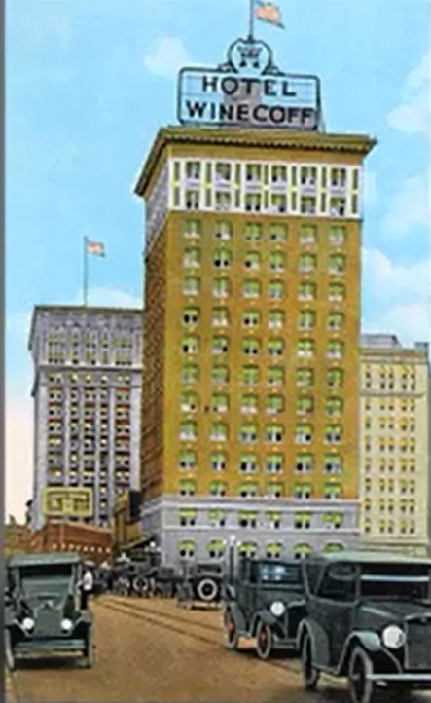
Winecoff Hotel
December 7, 1946
Atlanta, GA
119 Deaths, 32 Injuries
Hotel was billed as “absolutely fireproof”
Stairway was located in center of building.
Code requirements for fire suppression and fire alarm systems in hotels.

Slide 12
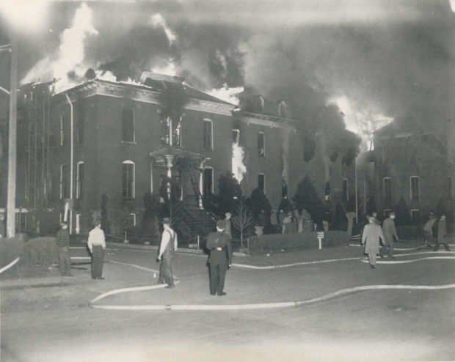
St. Anthony Hospital
April 4, 1949
Effingham, Illinois
74 Deaths

Slide 13
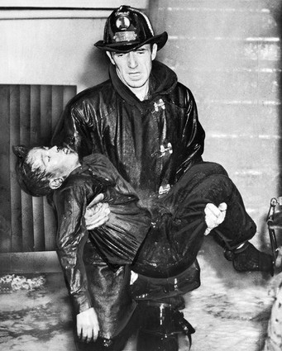
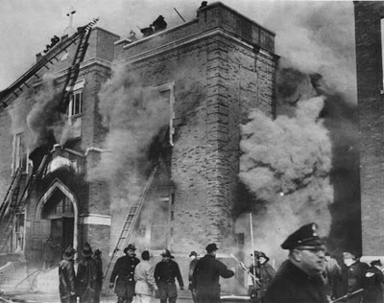
Our Lady of Angels
December 1,1958
Chicago, Illinois
95 Deaths
Code changes included Sprinkler Systems and Fire Alarms in schools

Slide 14
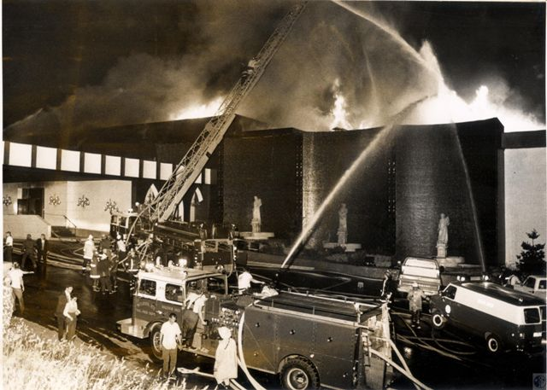
Beverly Hills Supper Club
Southgate, KY
May 28,1977
165 Deaths
Aluminum wire was banned as a result and sprinkler systems are required in Places of Assembly with a capacity over 300

Slide 15
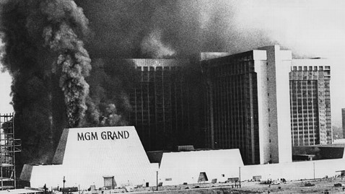
MGM Grand Hotel and Casino
November 21, 1980
Las Vegas, Nevada
85 People Died
Sprinkler system was not installed due to cost. Building Official overruled Fire Marshal insistence for a sprinkler system.

Slide 16
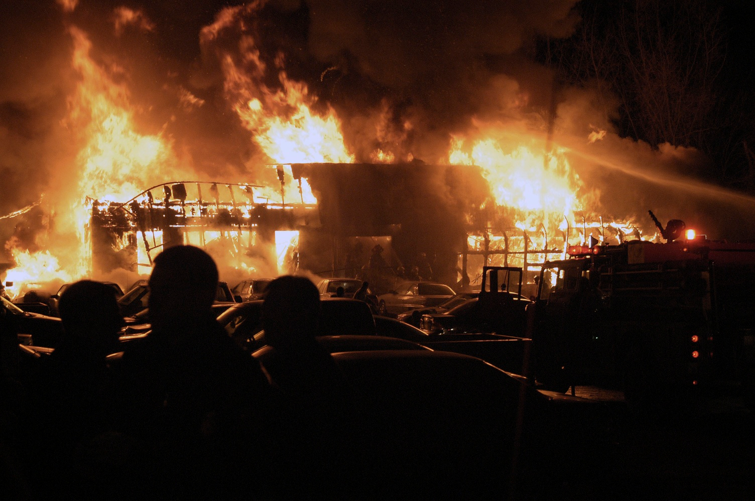
The Station Nightclub
February 20, 2003
West Warwick, RI
100 Deaths, 230 Injured

Slide 17
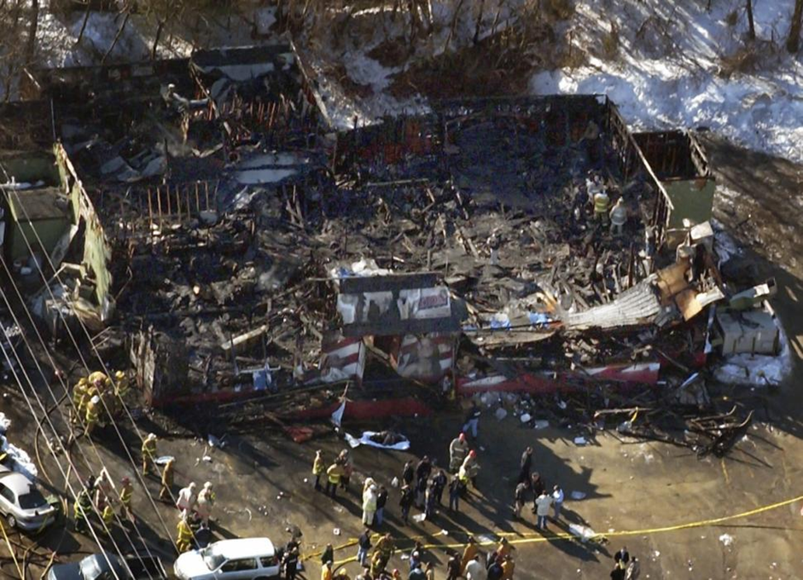
The Station Nightclub

Slide 18
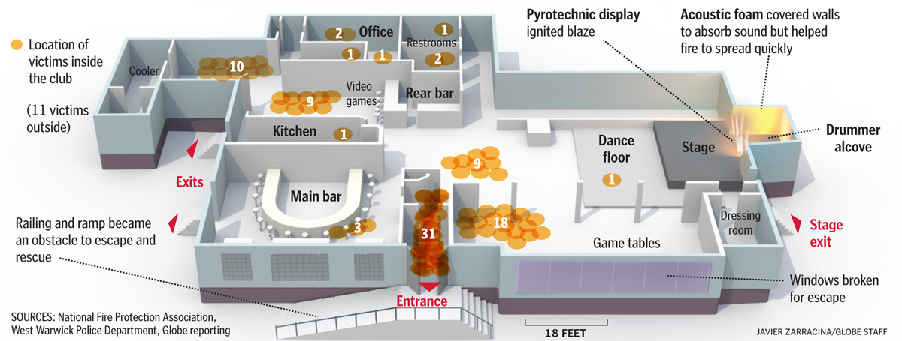
The Station Nightclub

Slide 19
The Station Nightclub
MICHAEL AND JEFFREY DERDERIAN, Owners of The Station
Grand Jury indictment charged each of them with 100 counts of involuntary manslaughter and 100 counts of misdemeanor manslughter. A 2006 deal allowed the two to plead no contest. Jeffrey was sentenced to 500 hours of community service, with no jail time, and Michael was sentenced to serve a four-year prison term.
DENIS LAROCQUE, West Warwick Fire Inspector
Never was charged but suffered blame from the victims for inspected the club twice in the years preceding the fire but failed to cite the owners for highly flammable materials that were on the walls and ceilings. He failed to notice the foam even though he would have had to reach through it to use the handle of a door he cited for opening the wrong way. Also, failed to note that The Station had been converted from a restaurant to a nightclub which would have required an automatic sprinkler system. He boosted the club’s occupant load twice, from 258 to 317 to 404.

Slide 20
The Station Nightclub
The survivors won a total of $175 million in civil settlements
In April 2003, the Rhode Island Workers’ Compensation Court ordered the Derderians to pay a $1.1 million fine for failing to take out workers’ compensation insurance for their Station employees.

